Slide 1

Eric Roden Capstone Presentation
November 2018

Slide 2
Issue Overview
80,000
Since 2012 Skytrax, an airline review website, has received approximately 80,000 airline reviews
4,500
In December 2017 American Airlines was receiving more than 4,500 mentions per hour¹
1,046
In February 2018, DOT received 1,046 complaints about airline service from consumers²
With so many comments and complaints how do airlines prioritize responses?
https://www.theatlantic.com/technology/archive/2017/12/on-the-other-side-of-your-airline-travel-tweets/548693/
https://www.transportation.gov/briefing-room/dot3318

Slide 3

Data Collection
Data Collection
Scraped 79,802 reviews from Skytrax.com
Each record contains:
Overall Rating
Text review
Traveler Information
Various rating fields (overall rating, seat comfort, etc.)
Prediction variable is “Recommended” which is either a yes or no
Not all fields were required but all reviews have the “Recommended” field, airline name, and text review
https://www.airlinequality.com/airline-reviews/etihad-airways

Slide 4
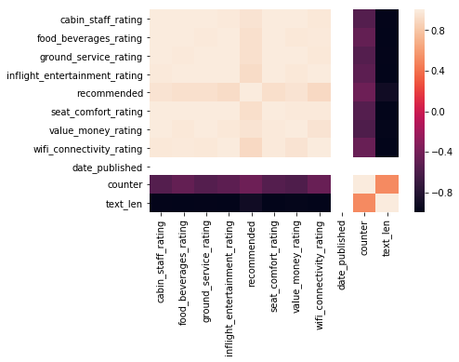
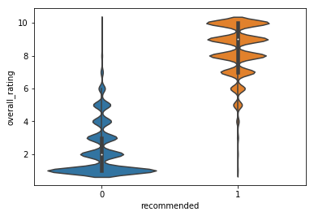
Data Exploration
Data Exploration
Null rate varied from 0% to ~50% for some fields
High correlation between many rating fields
8-10 overall rating scores led to recommended, 7-5 was mixed, and 1-4 was not recommended
Text length greatest for poor reviews
Most reviews fall into the extremes of the overall rating scale
Overall Rating
1
10
Text Length
https://www.airlinequality.com/airline-reviews/etihad-airways

Slide 5
Solution Details
Two models were built for recommendation predictions: one text only model that would be more applicable in the real world, one full survey model for this specific use case. Additionally a topic model was developed to understand the content of the reviews
Model | Inputs | Approach | Performance
Text Only Prediction | TF-IDF, Text Sentiment, Text Length | Logistic Regression (also tried XGBoost) | .8745 Accuracy .9411 AUC
Full Survey Prediction | TF-IDF, Text Sentiment, Text Length, five additional ratings (with some imputed values) | Logistic Regression (also tried XGBoost) | .9488 Accuracy .9907 AUC
Topic Model | Text Corpus | Latent Dirichlet Allocation | Used log likelihood and perplexity but ultimately down to personal evaluation

Slide 6
Demo and Deployment Discussion

